Slide 1
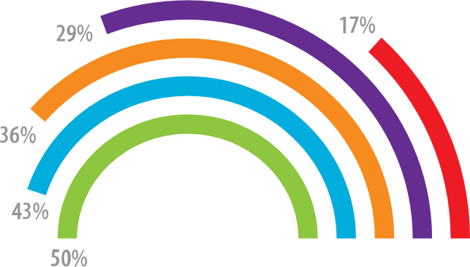
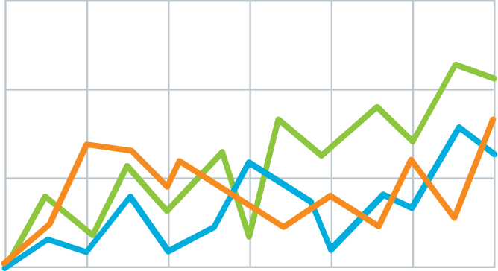
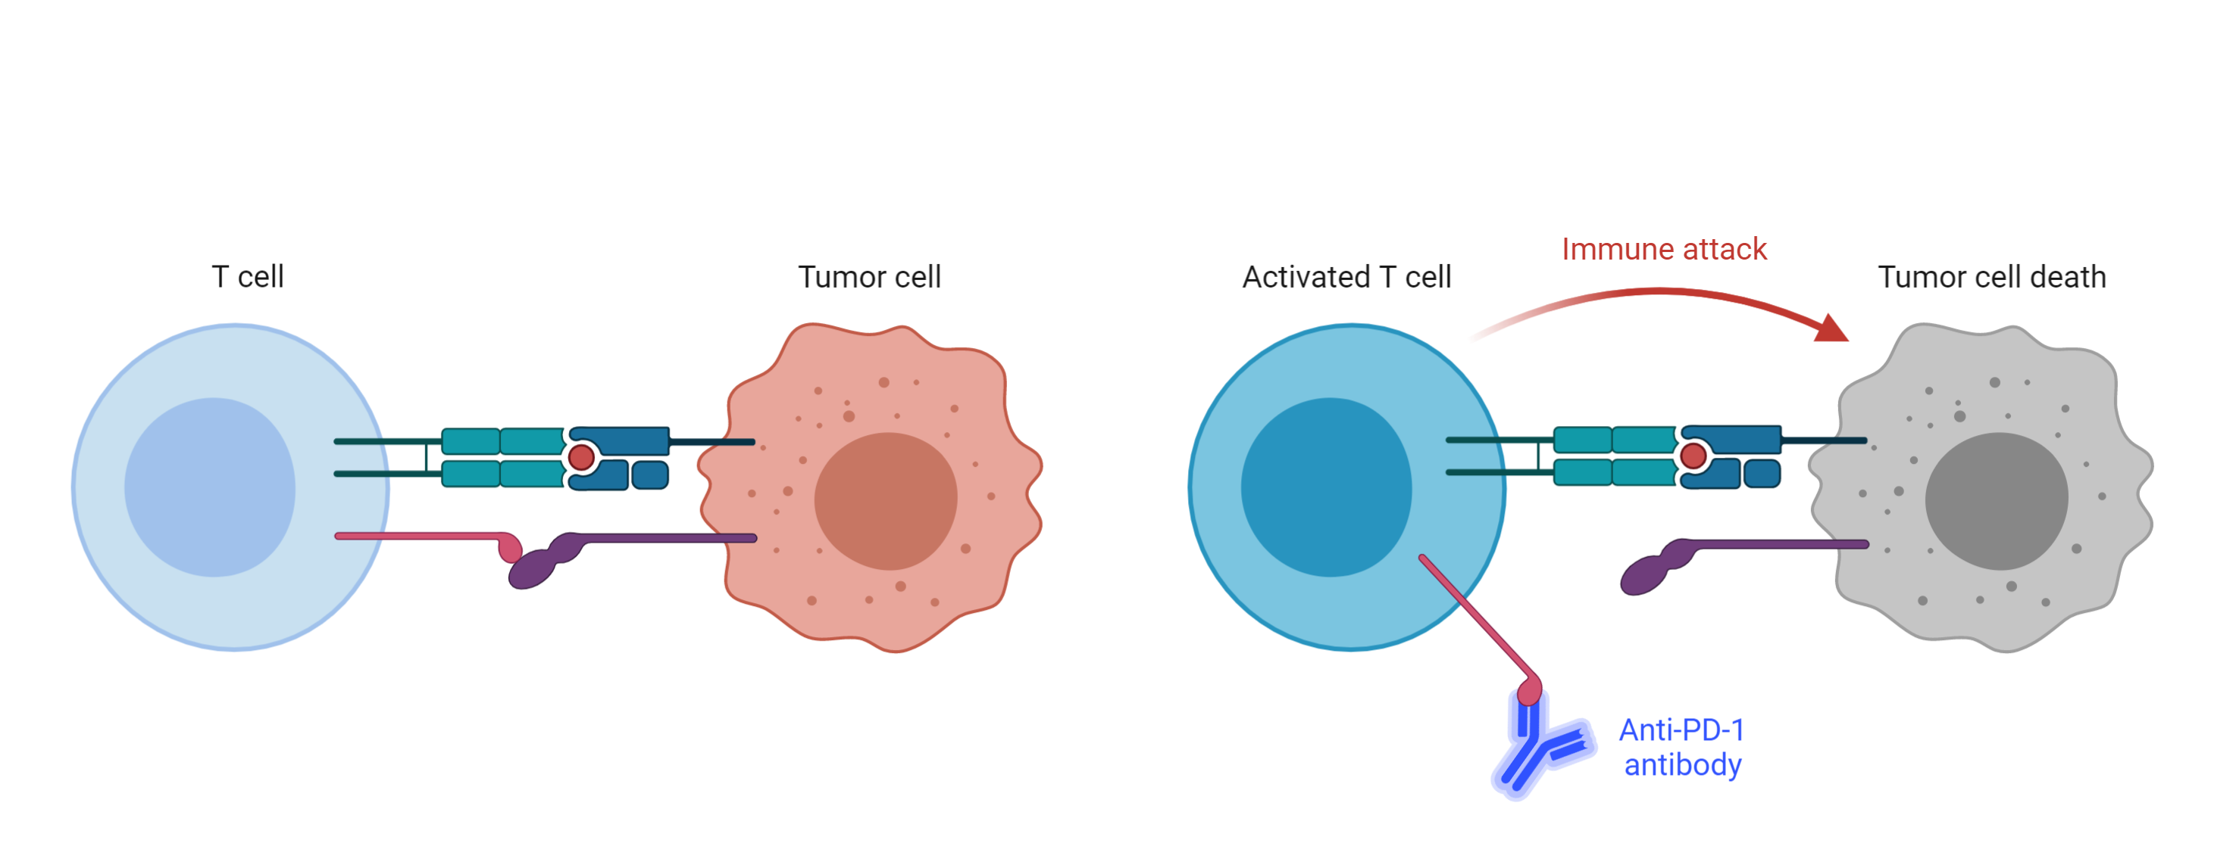
Teach people what you
learned in 5 seconds
(takeaway, not title)
Title goes here: Investigating the dynamics of X on Y.
Background: 70,000 people needed a portrait-orientation style layout for #betterposter, according to the Open Science Framework download counts.
Result 1: Quickly explain what the graph shows. Help people think.
Result 2: Big figures are easier to skim at a distance, and more accessible.
v
v
Methods
v
1
Immune checkpoint inhibits T-cell activation.
2
Anti-PDF-1 antibodies permit T cell activation
Considerations: This is only one interpretation of findings that suggest effective posters are uncluttered, have big figures & text, and include callout boxes with takeaways. It is missing your personality and creative flair.
PRESENTED AT:
Author 1, Author 2, Author 3

